Slide 1
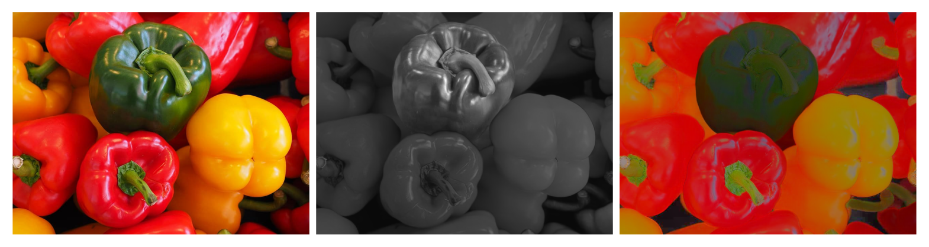
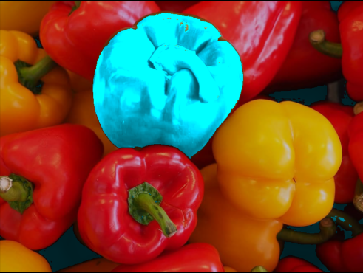

Slide 2
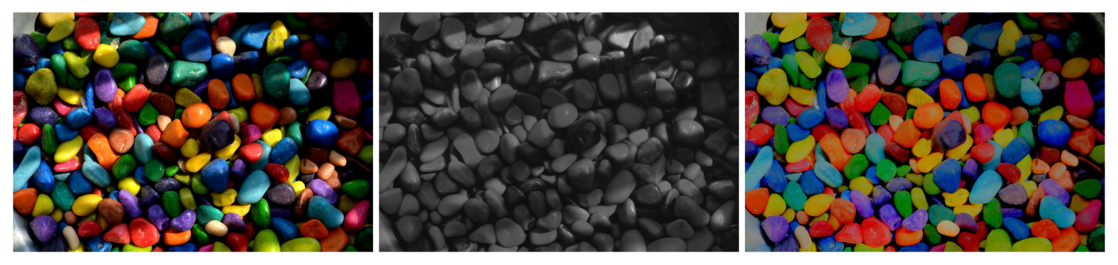


Slide 3
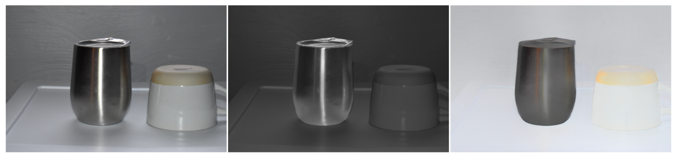
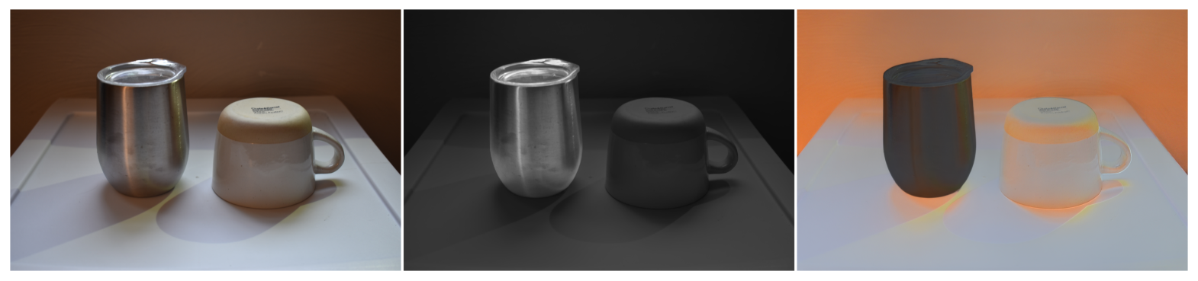

Slide 4
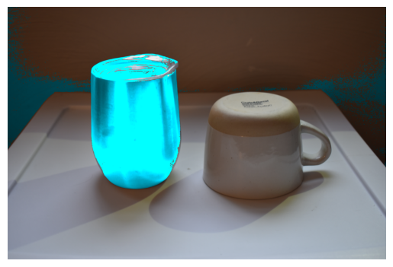

Slide 6
Intrinsic image decomposition for downstream image recoloring and retexturing tasks.
15-663 Computation Photography Final Project
Richa Mishra
Notes:
Helloo. I will present my final project for 15-663 computational photography

Slide 7
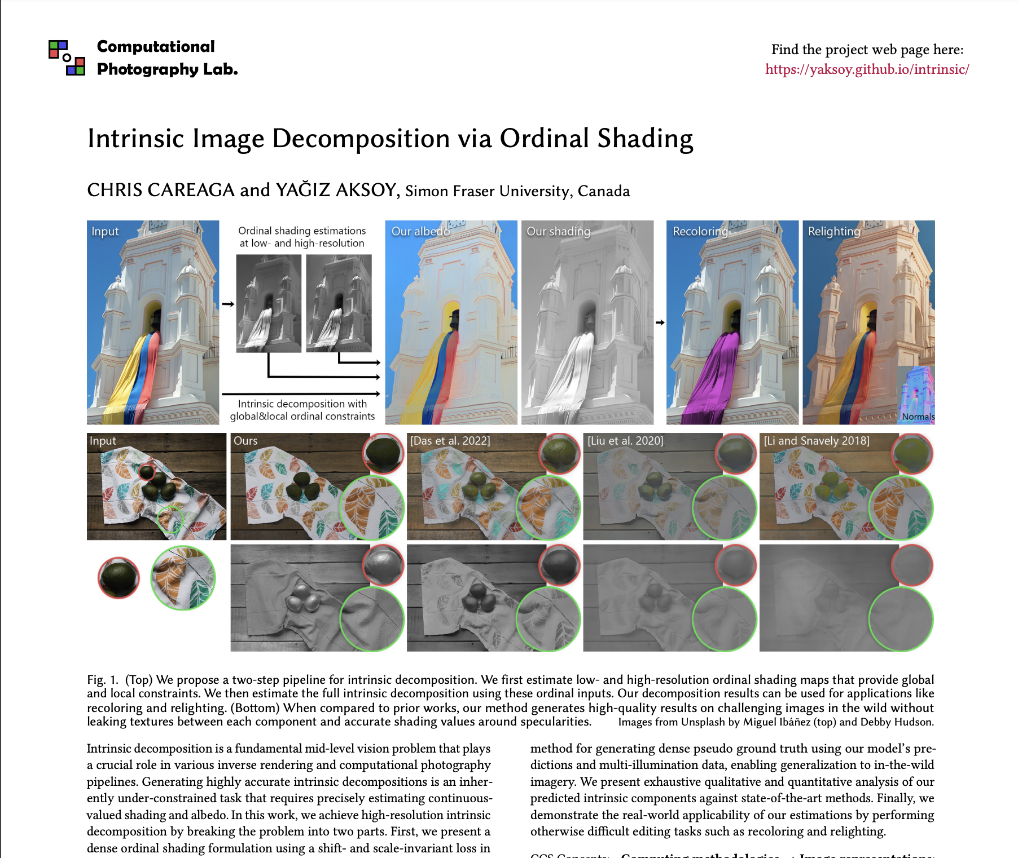

Slide 8
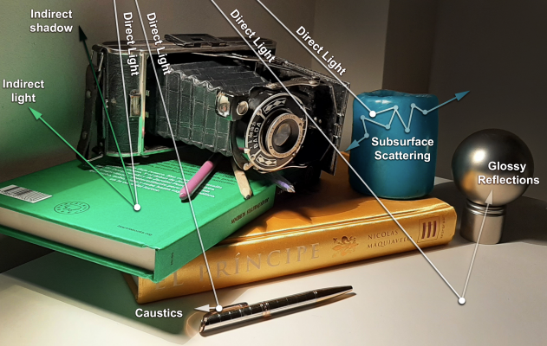
Light transport and material interactions
Image from Garces et al. A Survey on Intrinsic Images: Delving Deep Into Lambert and Beyond
Notes:
Shading is
heavily influenced by the complex nature of lighting in a scene, including direct and indirect illumination, varying
light sources, and shadows. Predicting shading accurately requires a model to capture the nuances of different lighting
scenarios, which can be a daunting task for data-driven methods Several other methods use two networks to predict shading and albedo separately and use a reconstruction loss.
However, these methods do not incorporate the scale-invariant nature of the problem

Slide 9
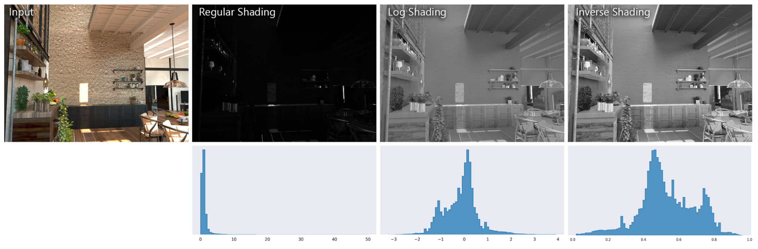
Inverse shading formulation
Image from Careaga et al.Intrinsic Image decomposition via ordinal shading
Notes:
Estimating shading using neural networks is not straightforward. The challenge arises from the fact that the illumination
can take on a large set of values due to specular objects present in the scene. This results in a long-tailed distribution of
values. One solution to this problem it to formulate the shading in the logarithmic scale. This prevents the long-tailed
distribution and is more uniform. But the logarithmic domain lacks contrast and a well-defined range. Using inverse
shading solves these two issues. The contrast is preserved and the shading range is between
[
0
,
1
]

Slide 10
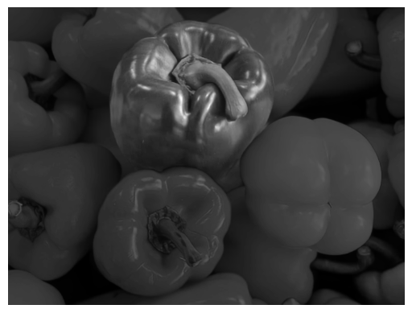
Ordinal shading
a
x
+b
Zero loss
Notes:
We have to incorporate the scale-invariant nature of the Equation 1 in out model. Since it is hard to directly estimate
dense shading values, the authors used a relaxed formulation of direct shading estimation. This means that the network
is not taked to predict the final shading values. Instead the network is only tasked to learn the relative ordering between
the shading values.

Slide 11
Method
High resolution ordinal shading
Intrinsic image decomposition
Upscale
Low resolution ordinal shading
Notes:
The authors define a two-step approach to solve intrinsic decomposition problem. the first ordinal estimation,
generated at the receptive field resolution of the Ordinal shading network. Since it is at the receptive field resolution,
there is global coherency. The ordinal shading network is able to provide accurate ordering of the shading values across
the entire image.
provide a good starting point point for the final dense shading estimation. The final prediction
is generated at a higher resolution. This lacks global coherency but contains local detailed discontinuities
which provide the high frequency details to the second intrinsic decomposition network. The task of our intrinsic
decomposition network is simplified with these three inputs. The network does not have to reason about the global
structure like illumination direstion and geometry as it comes from
. The network does not have to reason whether a
sharp change in RGB near edges is a change in shading or aldedo as this information is provided in the form of
. The
network simply has to adjust the values of
such that it satisfies intrinsic model of Equation 1 while also including
the details from

Slide 12
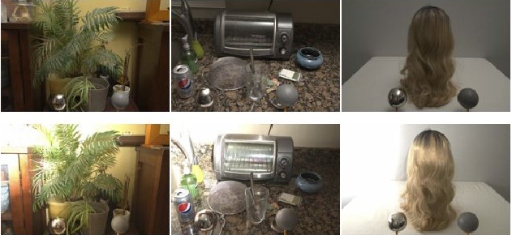
A Dataset of Multi-Illumination Images in the Wild

Slide 13
Input images from Shekhar et al. Interactive Photo Editing on Smartphones via Intrinsic Decomposition

Slide 14
Recoloring example using segment anything

Slide 17
Recoloring on metallic surfaces

Slide 18
Proposed method to remove specularity effects
High resolution ordinal shading
Upscale
Specular mask
Intrinsic image decomposition
Specularity removal
Upscale
Low resolution ordinal shading
Notes:
Specular Highlight Removal for Real-world Images

